Slide 1


Slide 2
Understanding Housing Markets
Notes:
Q: We regularly hear about the housing affordability crises, before unpacking the specifics around affordability, lets start at the highest level and how you assess the state of a housing market?

Slide 3
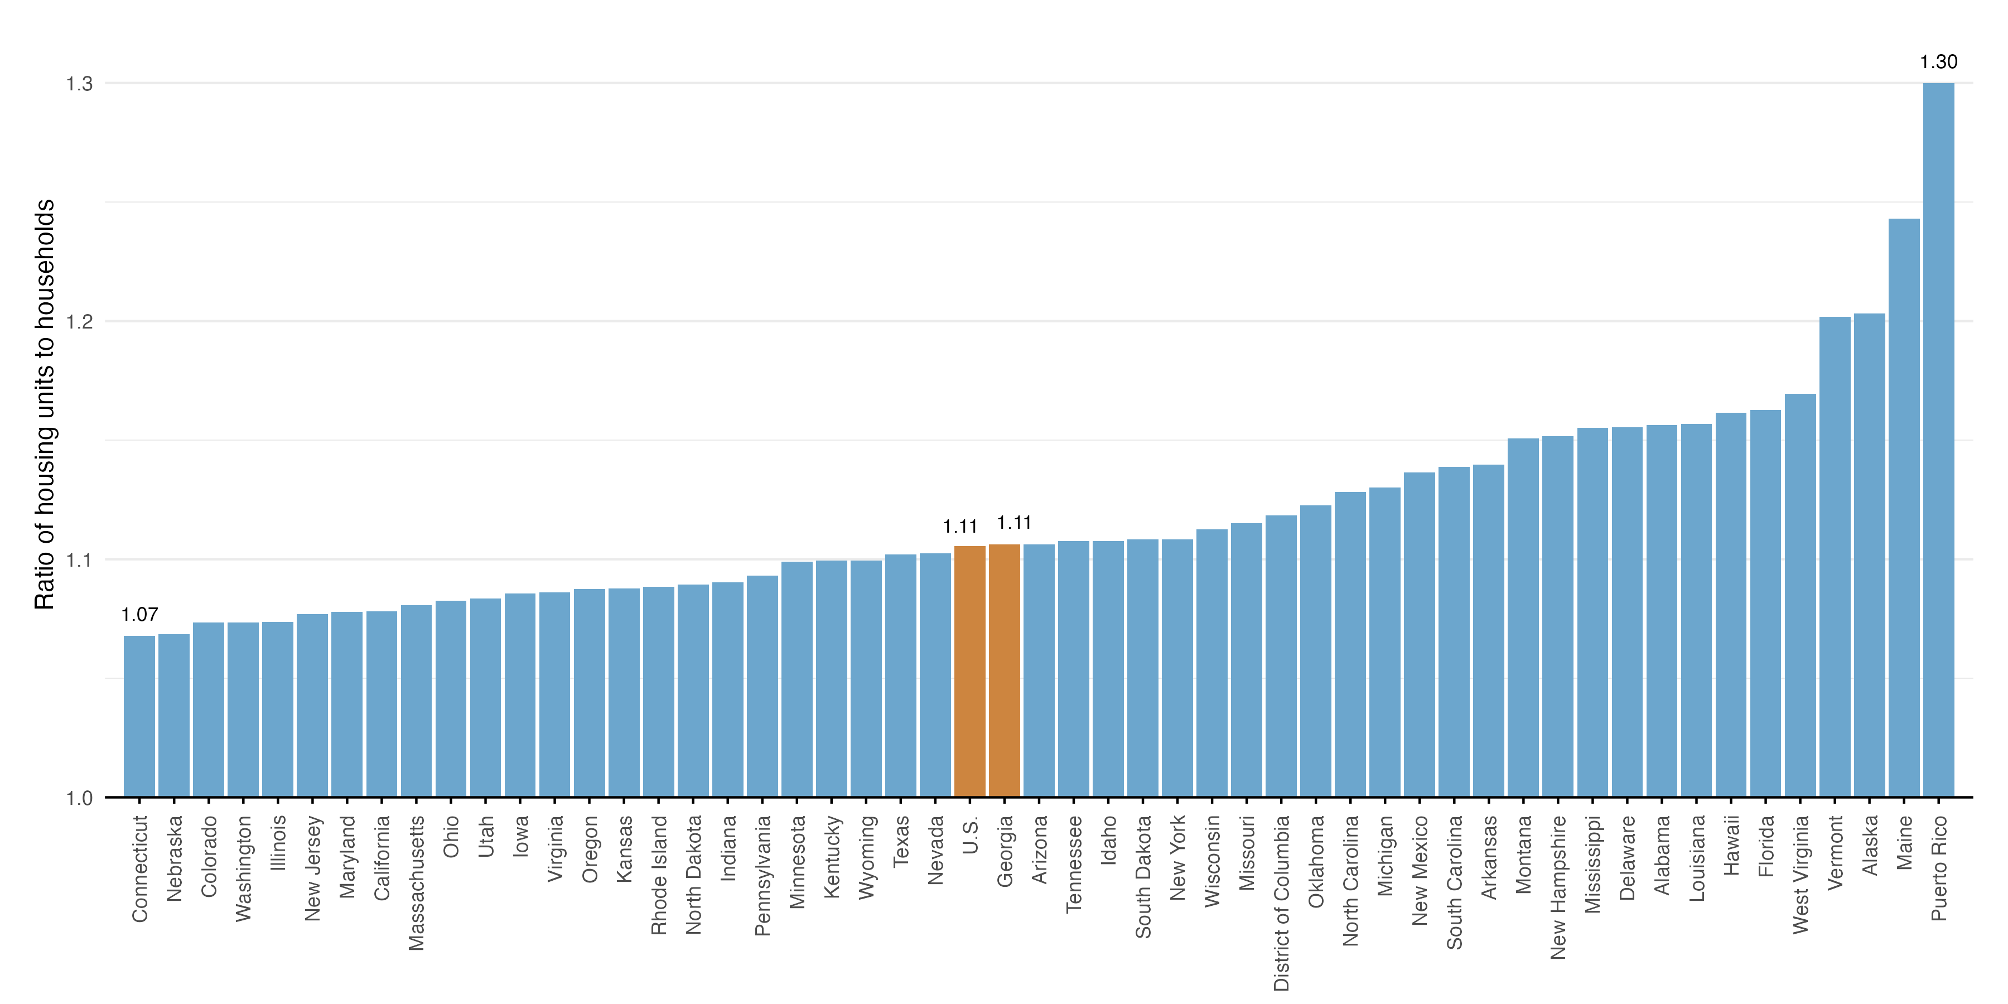
Georgia looks like the US average
Ratio of housing units per household in 2024
Source: U.S. Census, 2024 1-year ACS
Notes:
Q: Is there anything unique about Georgia and and how to interpret what appears to be nothing that would stand out as a red flag as it relates to supply and demand

Slide 4


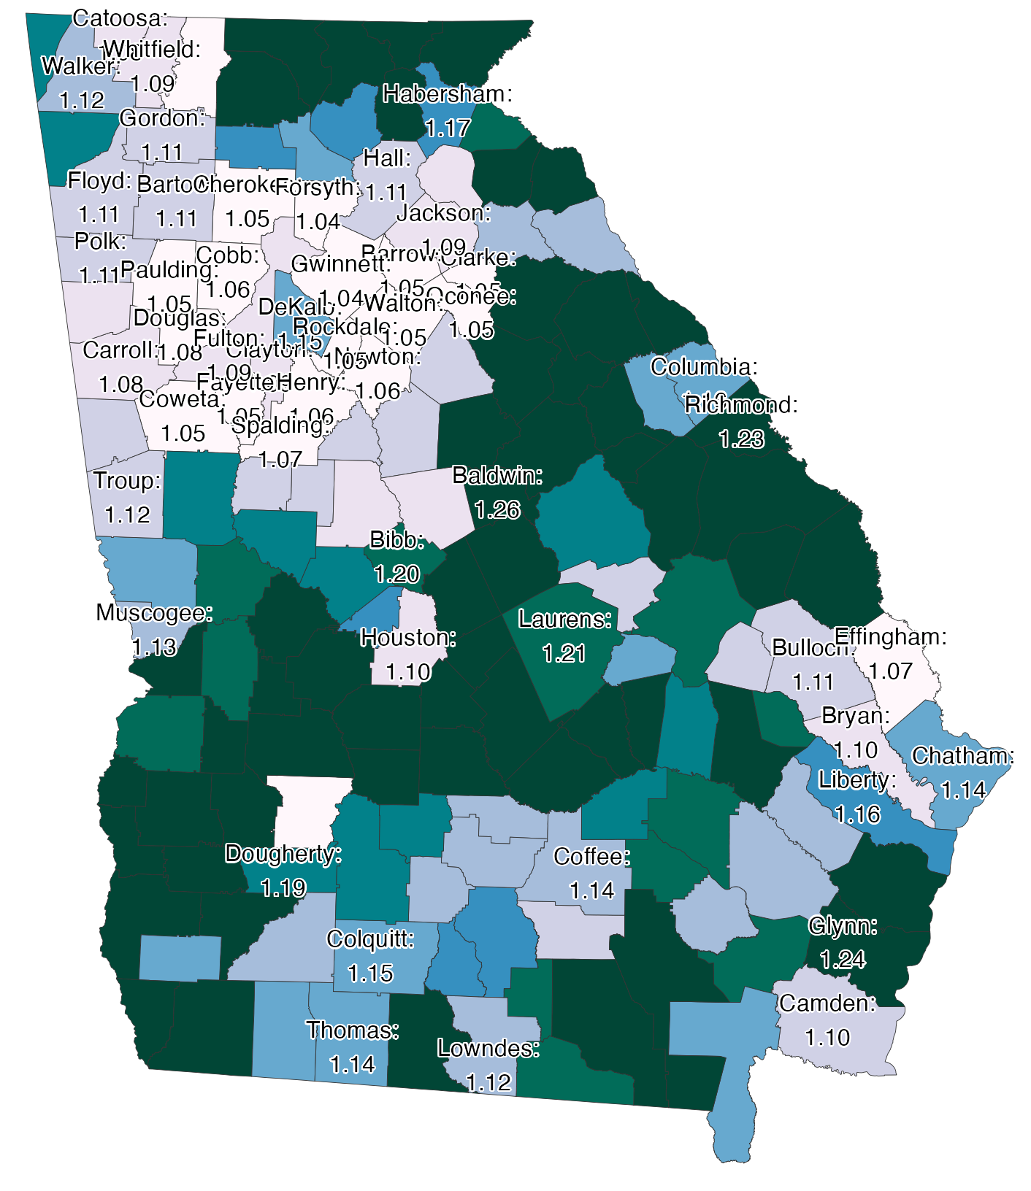
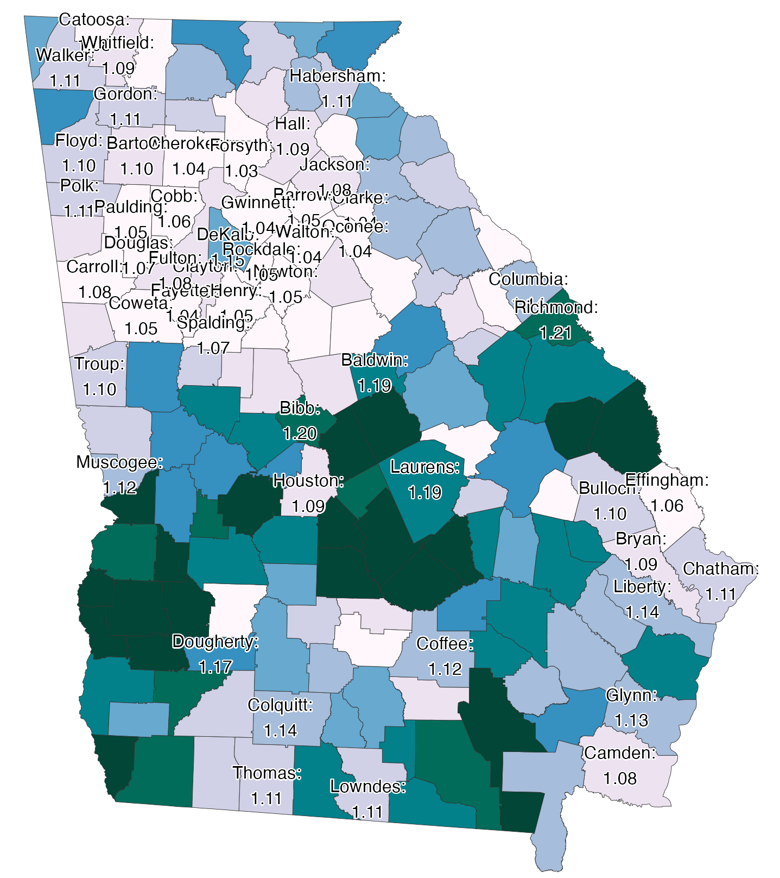
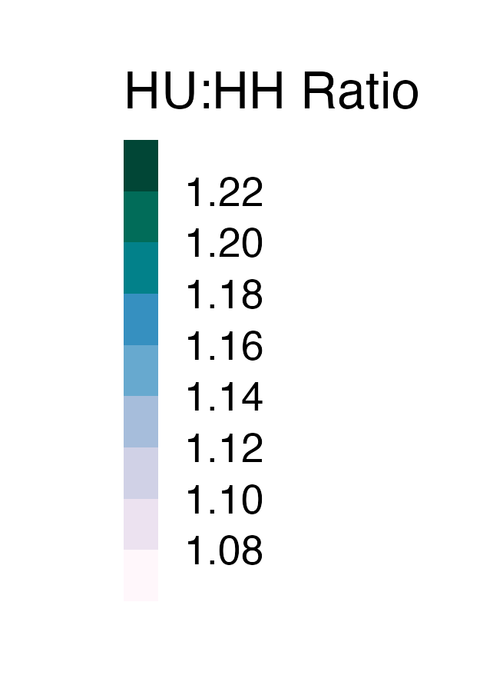
Constraints in urban core and surrounding suburbs
Source: Census ACS 2022 5 year sample
Notes:
Q: Mapping the number of units compared to the number of households by county shows varied market conditions across the state. How would you unpack this further?

Slide 5
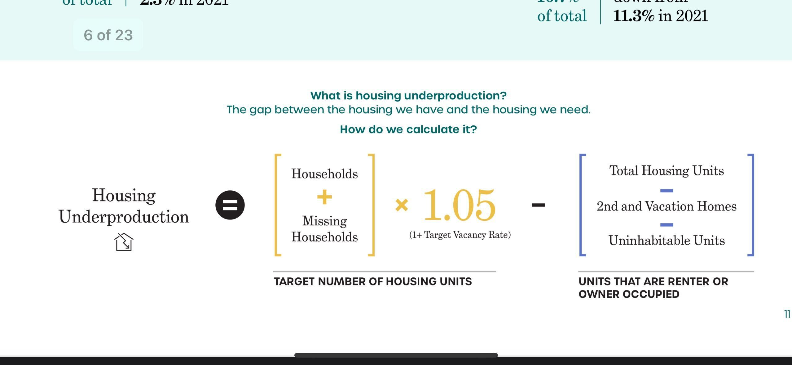
Measuring housing underproduction
Demand
Supply
Notes:
Q: How does underproduction in Georgia and within the Atlanta Metro compare to nationwide trends?

Slide 6
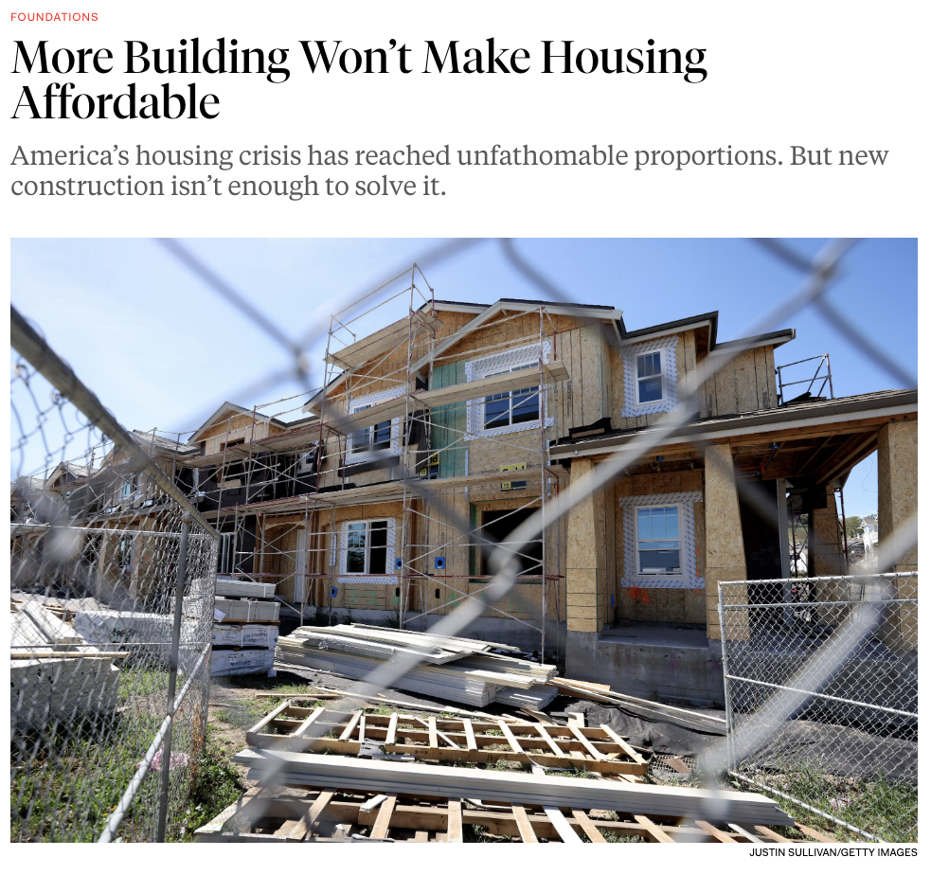



What is affordability, anyway?
Notes:
Q: There is a continuum of viewpoints on the impact of supply in influencing the housing affordability crises. Where is a good place to start unpacking this relationship?

Slide 7
Why Supply?
Notes:
Q: Given the connected but different ways in which the affordability crises is felt by households, how does increasing supply interact with peoples lived experiences?

Slide 8
Housing production has short run and long run benefits
Short Run
-Elasticity
  The relationship between supply and price.
-Income Sorting / Vacancy Chains
  Households rarely spend exactly 30% of their income on housing, households that spend less crowd out lower income households.
Long Run
  -Filtering
  Depreciation of older housing stock over time.
Notes:
Q: Lets start with elasticity, how does this work in practice?

Slide 9
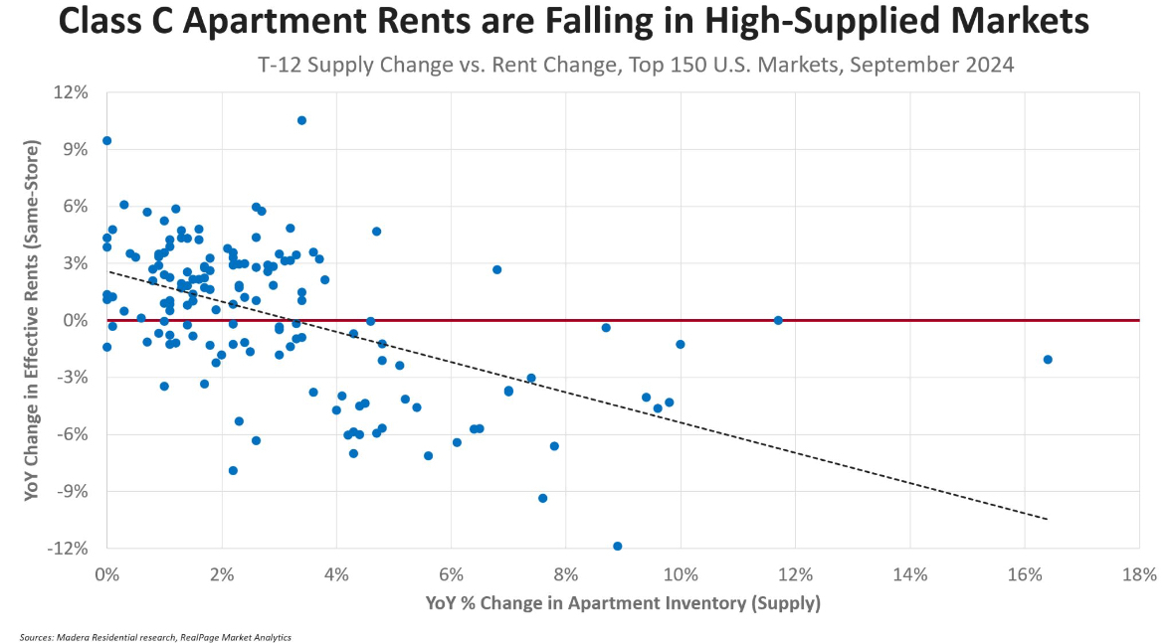
Short run affordability benefit occurs only when production is sustained
Notes:
Q: What about other short run benefits to building more housing?

Slide 10
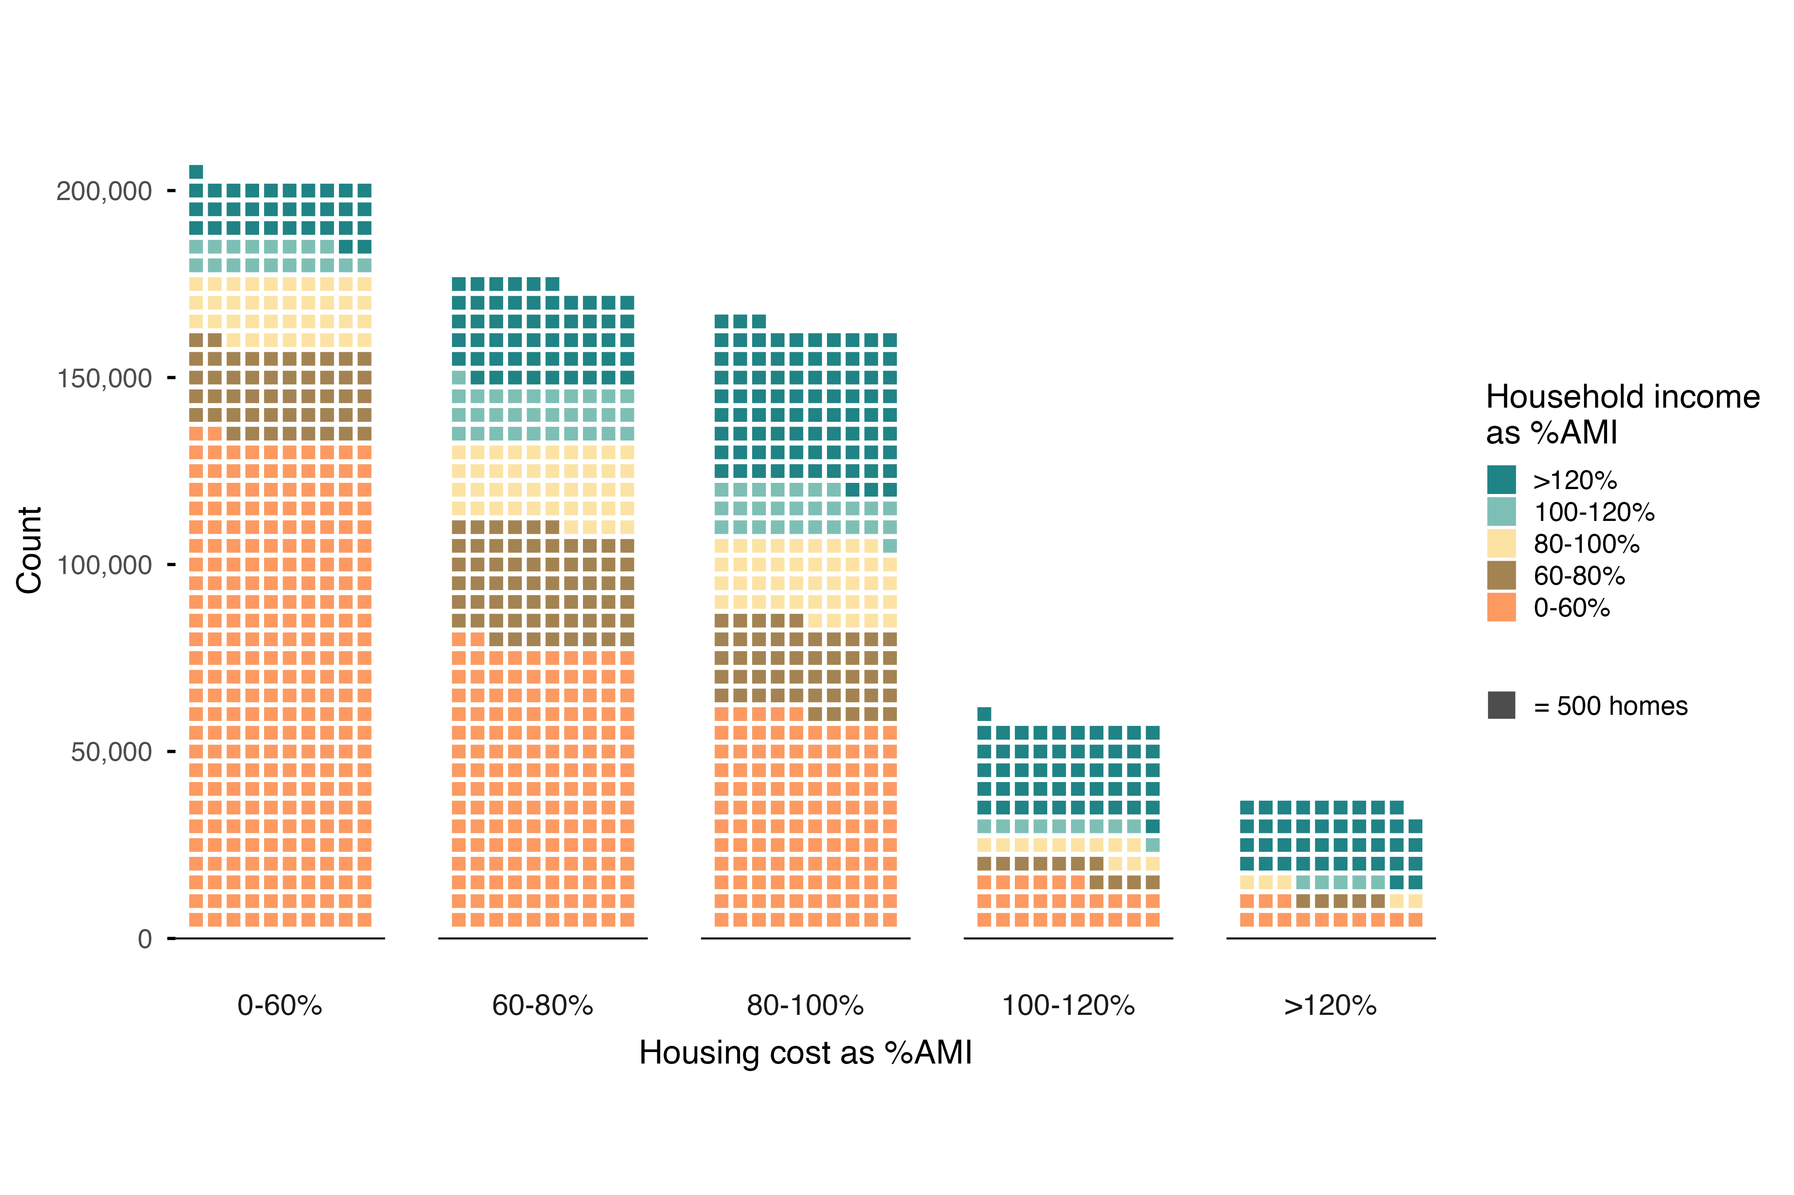
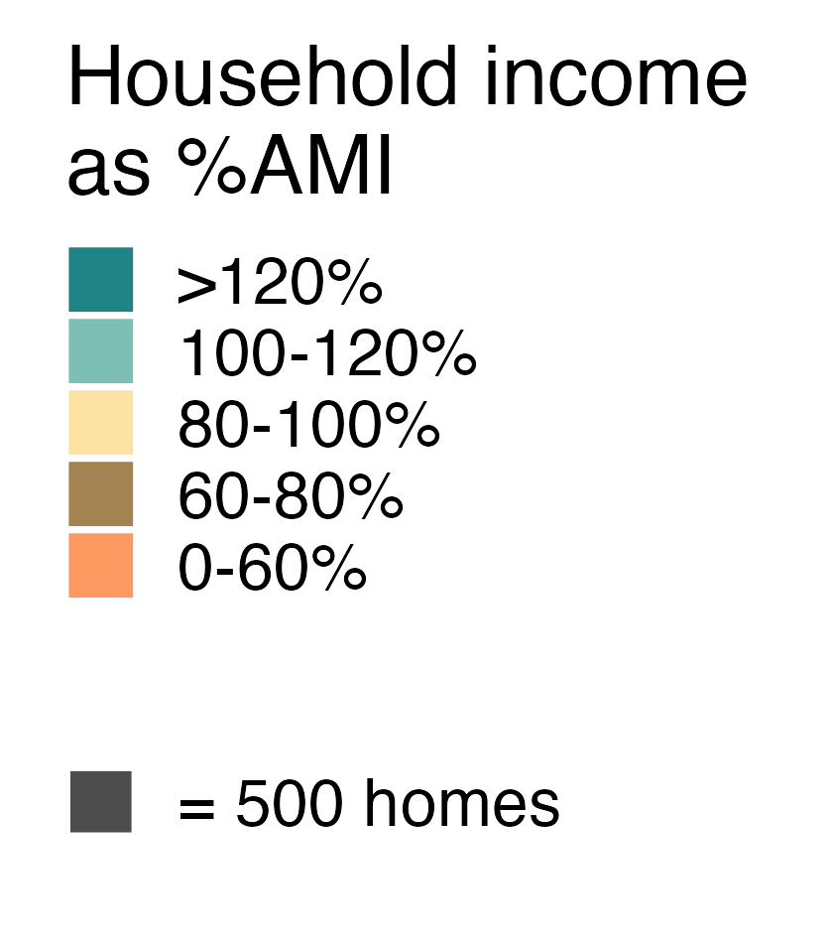
Households don’t perfectly sort by income into rental units
Household income distribution
Renters occupying apartments affordable from 0 to 60% of AMI
Atlanta MSA, 2024
Units
Notes:
Given this mismatch, how does building a new unit of housing change the mismatch?

Slide 11
Higher income renter households reduce availability of affordable units
Renter Household income distribution by unit affordability
Atlanta MSA, 2024
Notes:
Given this mismatch, how does building a new unit of housing change the mismatch?

Slide 12
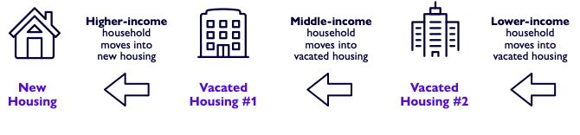
Vacancy chains free up units lower down the affordability ladder
Step 1
Step 2
Step 3….
Notes:
Q: So if those are the primary short run mechanisms, what are the long term benefits to building more housing?

Slide 13
Filtering occurs over two decades, then stabilizes
Building level rent for 1 bedroom units – City of Atlanta – 4Q 2025
Filtering
Stabilization
Notes:
MW to click to next slide as part of explanation…

Slide 14
In Atlanta, filtering occurrs at the low end of the range
Building level rent for 1 bedroom units – City of Atlanta – 4Q 2025
Research finds the rate of filtering by decade is typically between 5% and 20%
Units filter at a rate of 7% per decade
($100 per decade on average rent of $1,475)
Notes:
What are the limitations to supply, and what how should this inform the policy framework?

Slide 15
Policy Framework

Slide 16


